Slide 1
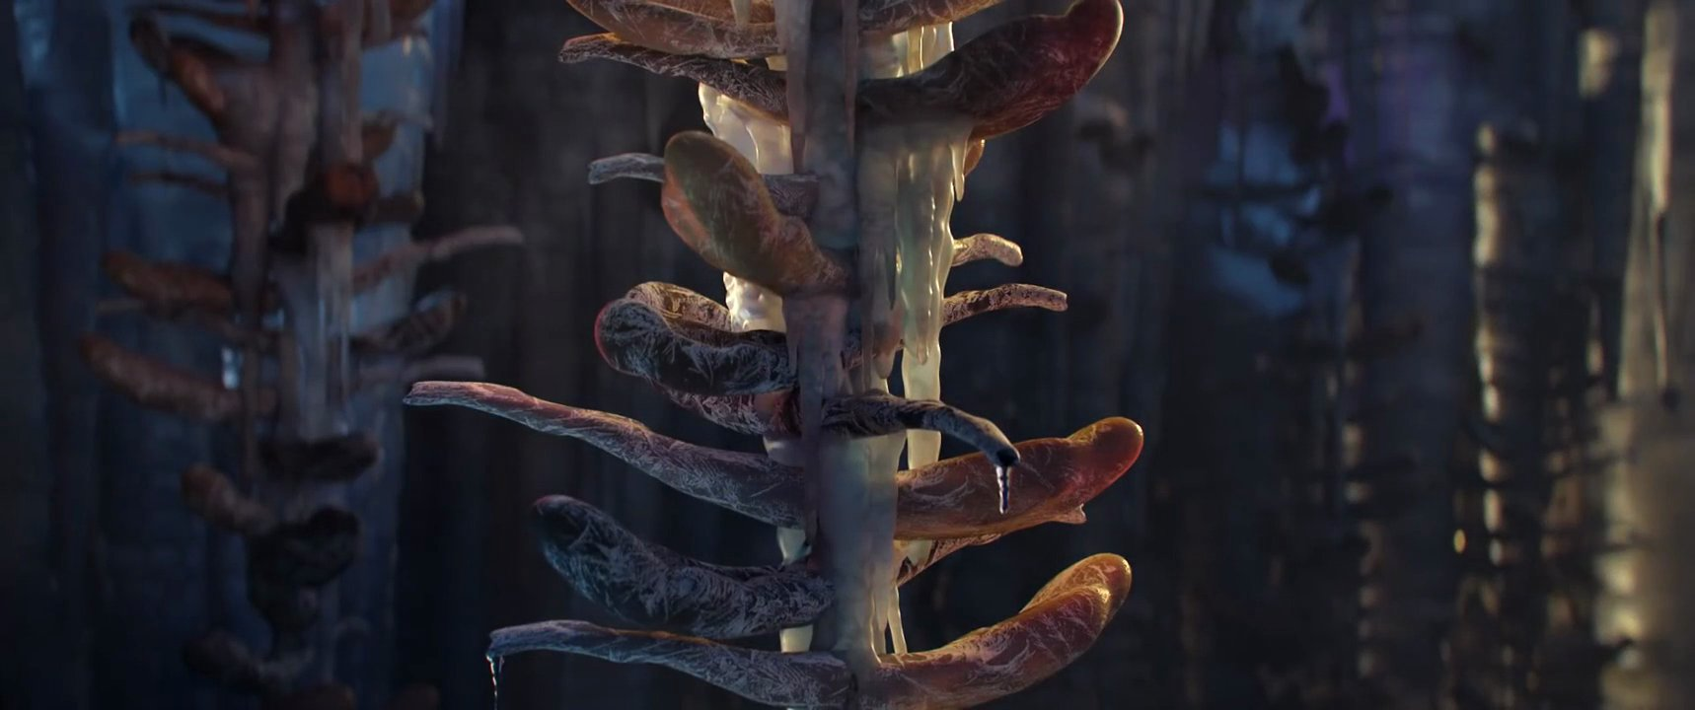
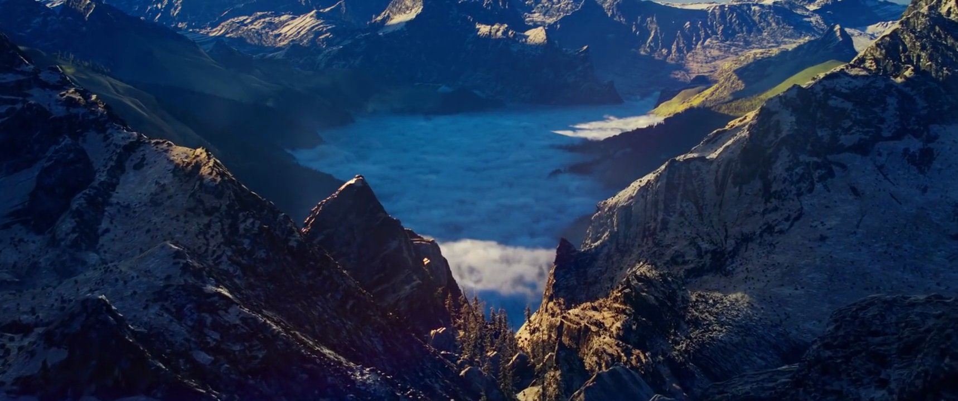
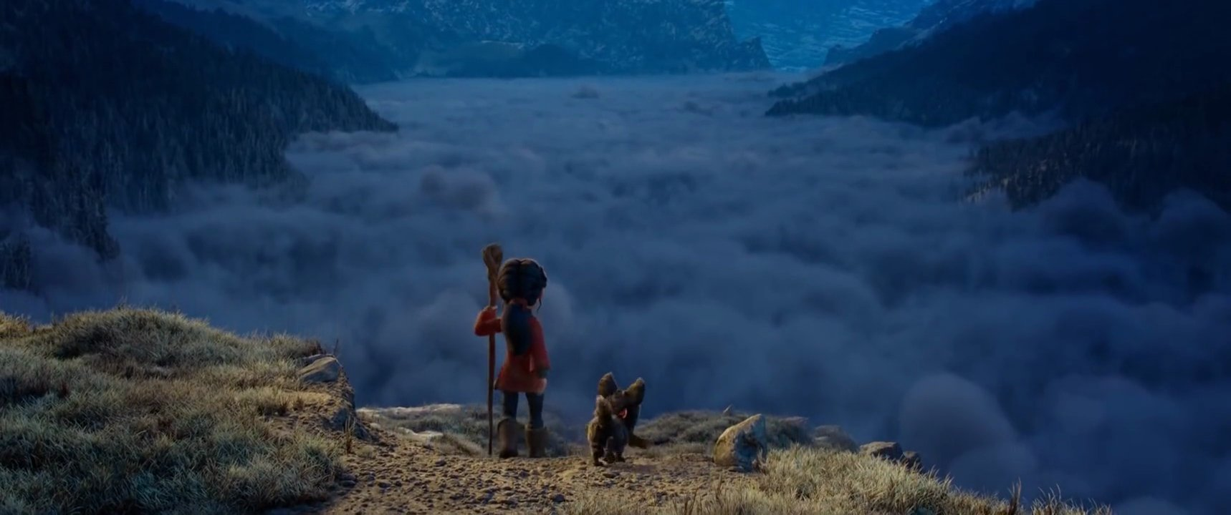
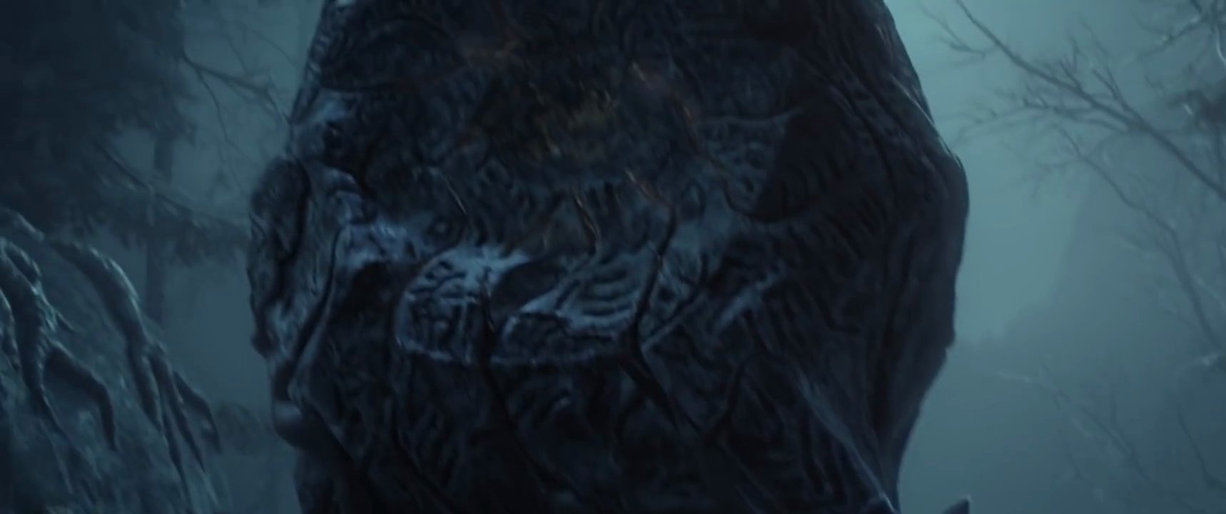

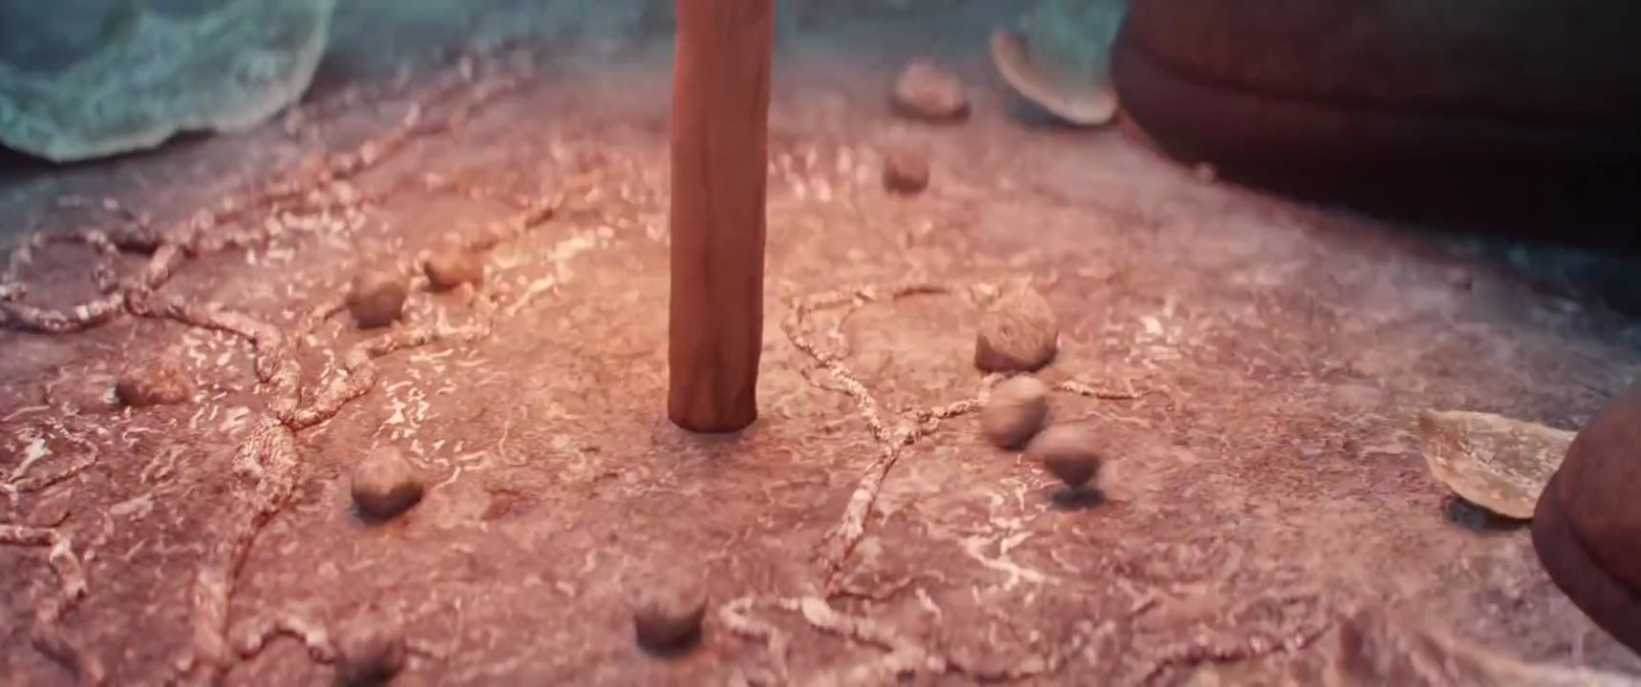
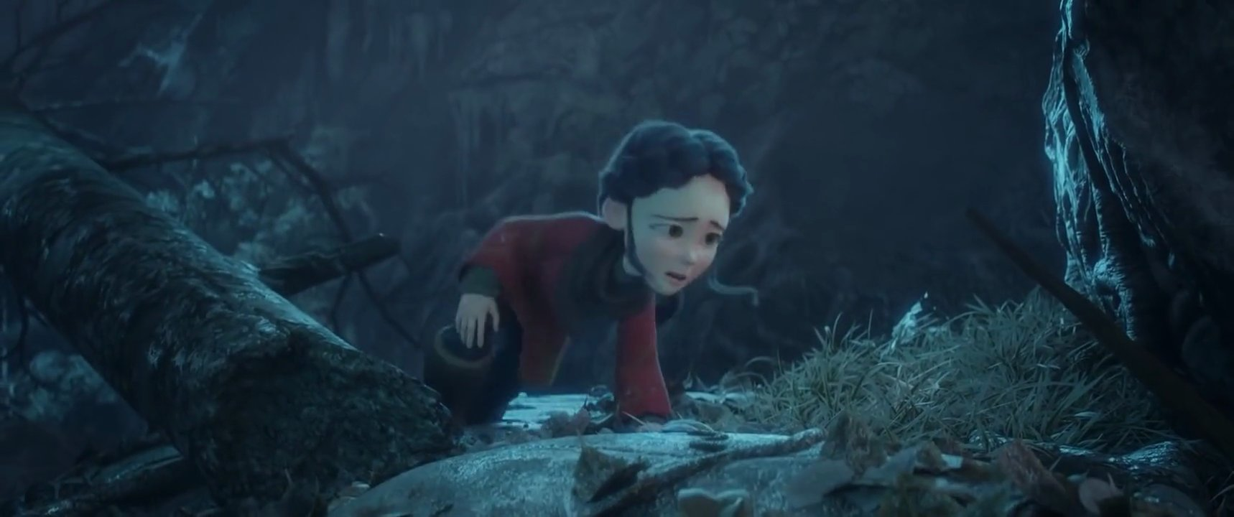
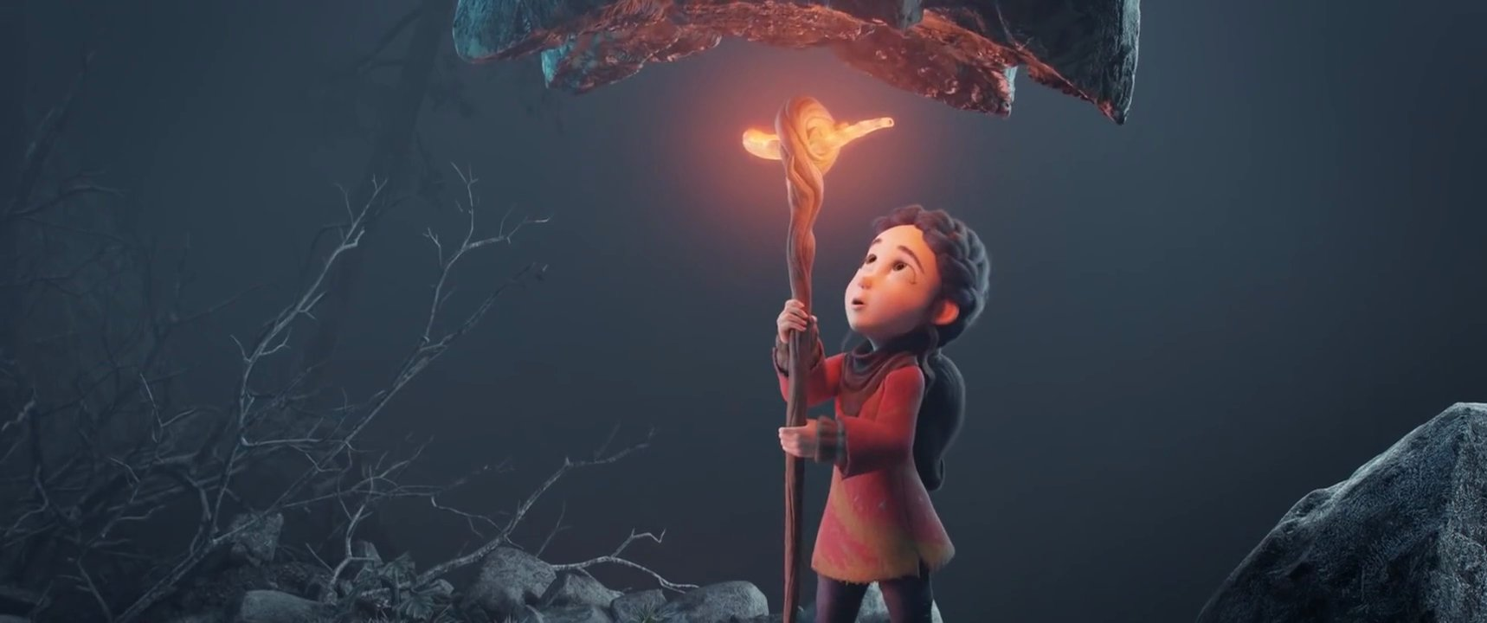
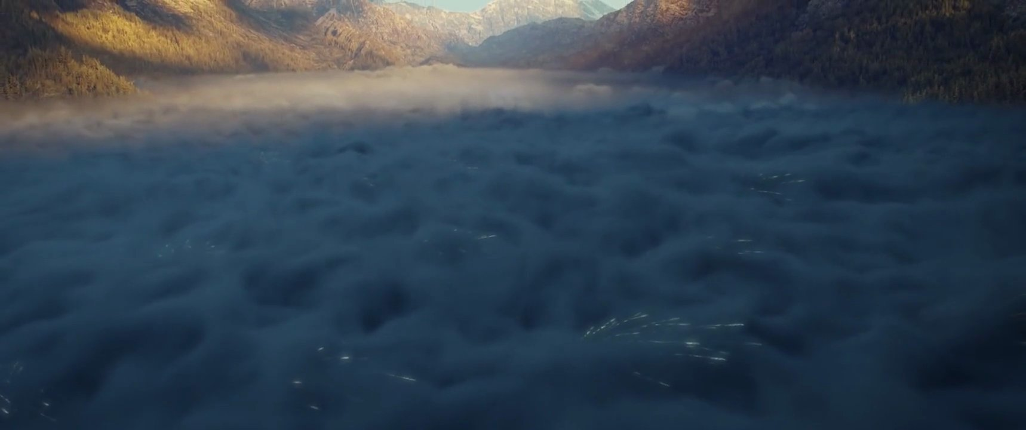

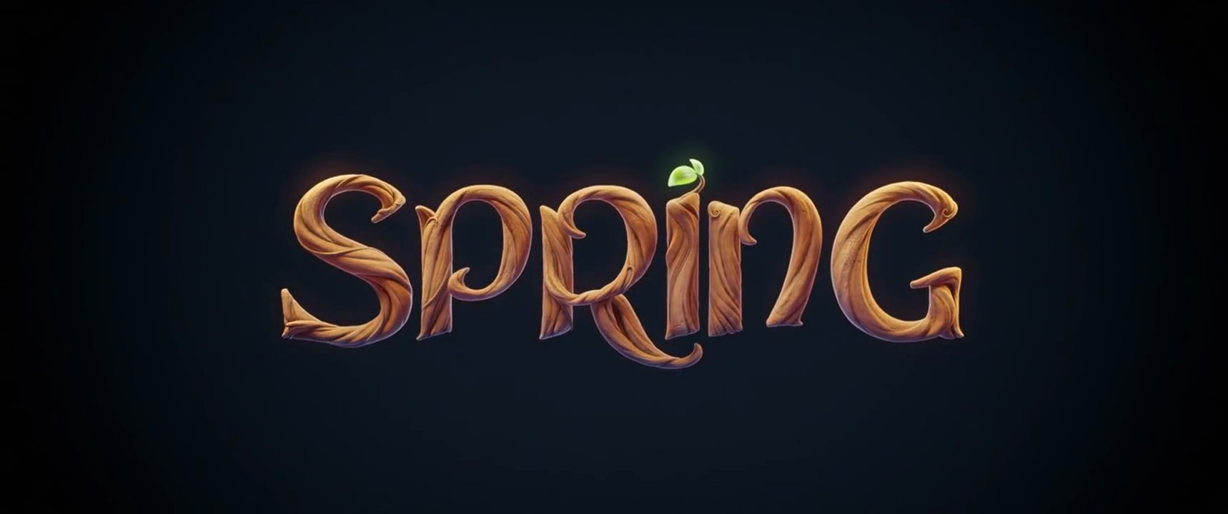
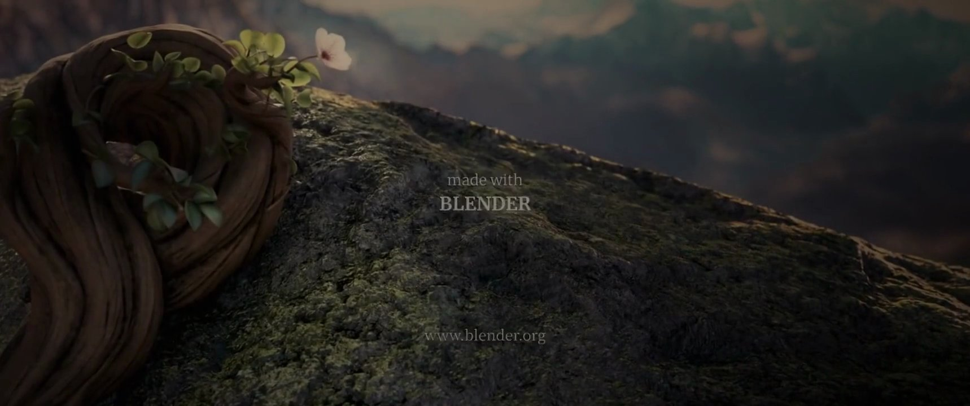
Page 1
SPRING: Production Review (CC BY 4.0)
Source: © Blender Foundation,
cloud.blender.org/spring, CC BY 4.0
Opening landscape: establish the scale
Character beat: hold for review
Movement reference: check screen
direction
#1
00:05:20
#2
00:27:12
#3
01:15:01
#4
02:09:01
Environment detail: compare alternate
crop
Action beat: confirm timing
Transition reference: keep visual
continuity
Creature reveal: review emphasis
#5
03:06:14
#6
03:55:13
#7
04:30:22
#8
05:07:15
Lighting reference: preserve contrast
Reaction beat: check pacing
Title card: confirm duration
End frame: clean handoff reference
#9
05:40:12
#10
06:10:12
#11
06:59:07
#12
07:36:04
Notes:
#1 — Source: © Blender Foundation, cloud.blender.org/spring, CC BY 4.0
#2 — Opening landscape: establish the scale
#3 — Character beat: hold for review
#4 — Movement reference: check screen direction
#5 — Environment detail: compare alternate crop
#6 — Action beat: confirm timing
#7 — Transition reference: keep visual continuity
#8 — Creature reveal: review emphasis
#9 — Lighting reference: preserve contrast
#10 — Reaction beat: check pacing
#11 — Title card: confirm duration
#12 — End frame: clean handoff reference

